Slide 1
CarX Rental
Duy Nguyen
An nguyen

Slide 2

Overview

Slide 3

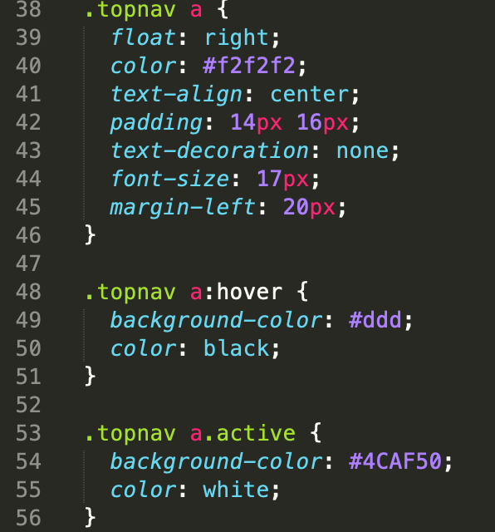
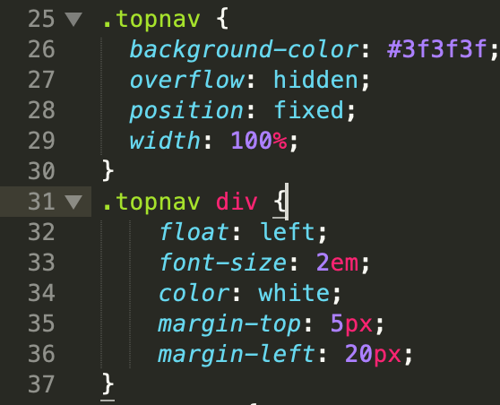
CSS Properties - Navigation Bar

Slide 4

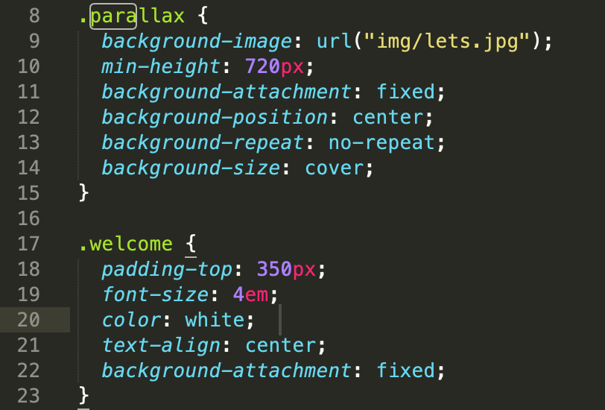
CSS Properties – Parallax Image

Slide 5

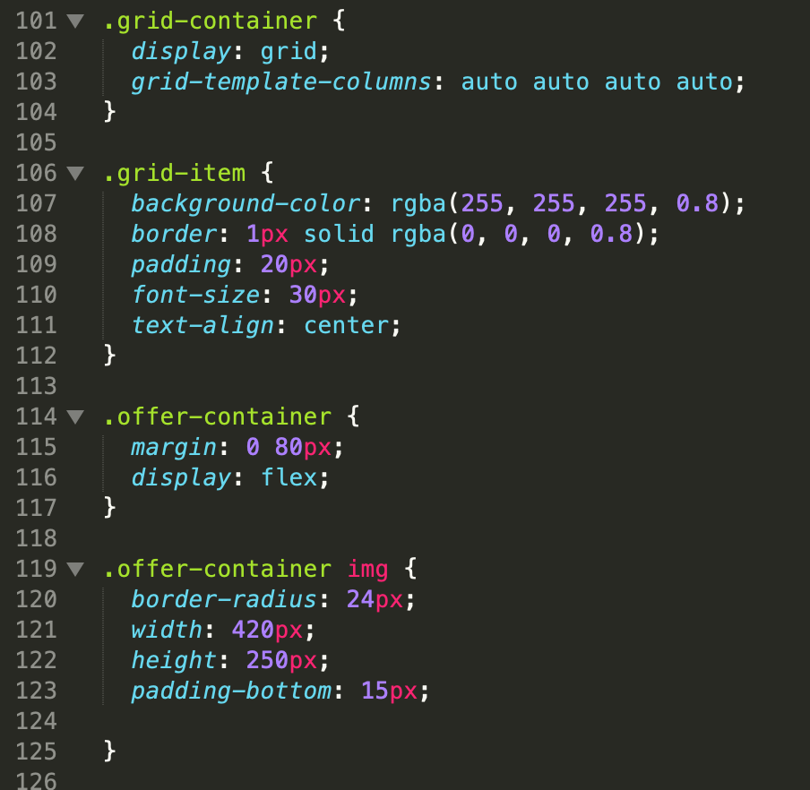
CSS Properties – Grid Col

Slide 6

HTML - Form

